Slide 1
AskSlotMachine II
iOS iphone 100 + lucky draw app

Slide 2

Lucky draw slot machine

Slide 3
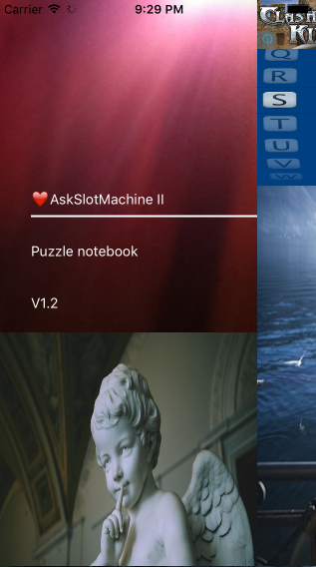
Sliding panel

Slide 4
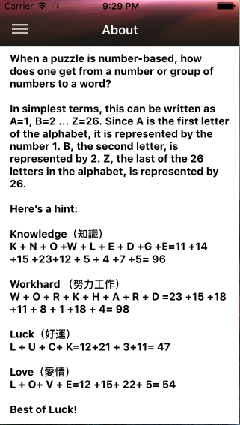
Puzzle notebook

Slide 5
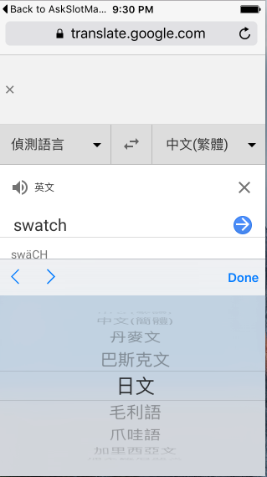
Multilingual translations

Slide 6
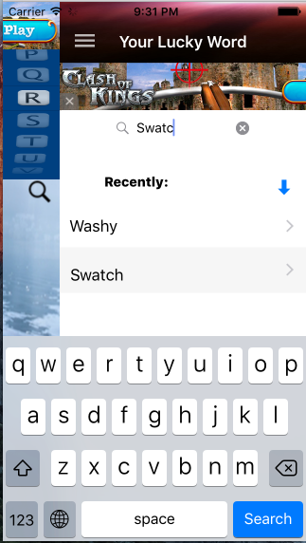
List words looked up

Slide 7
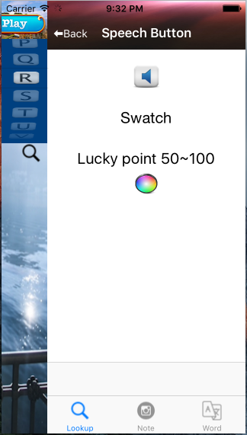
Look up recent word

Slide 8
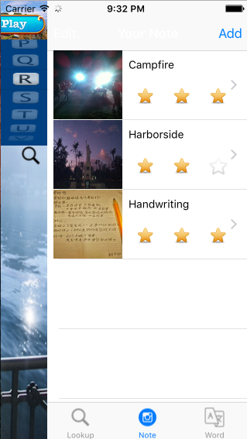
Photo Note with Ranking

Slide 9
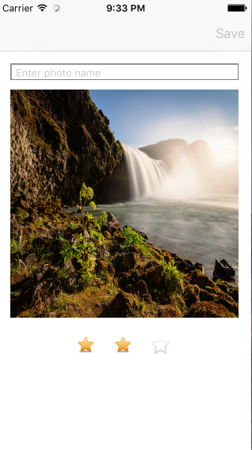
Edit photo note

Slide 10
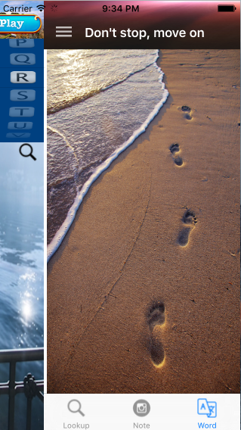
Don’t stop, move on

Slide 11
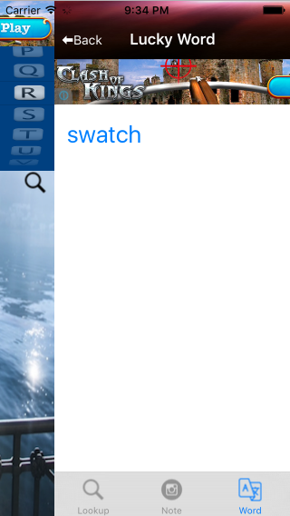
Lucky word

Slide 12
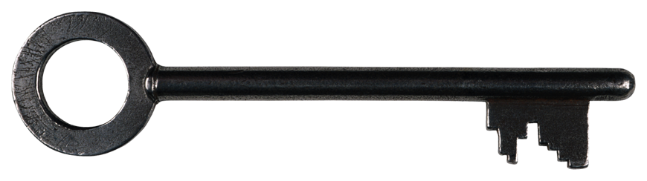
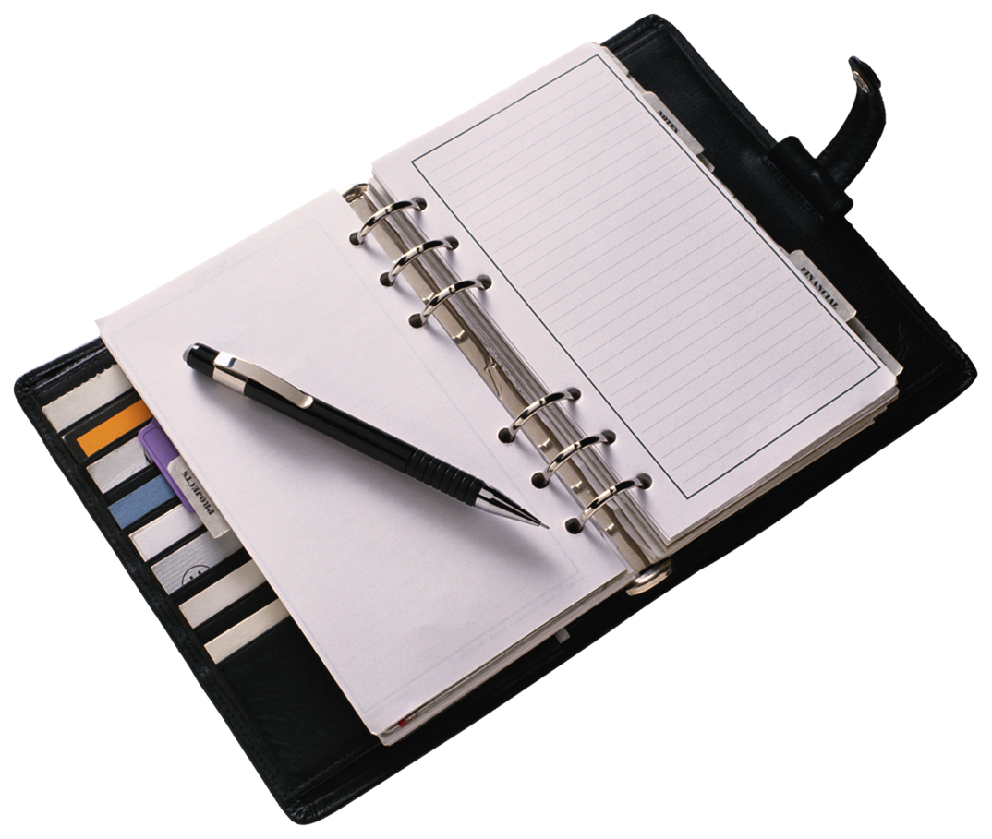
Thank You!

